Slide 1
INDIAN AIR QUALITY
Visualizing a Decade of CPCB Air-Quality Data
Data-driven insights from 298 Indian cities over ten years
PREPARED BY INTERN
DATASET
Zaid Khan
CPCB daily AQI bulletins (2015–2025)
AKI’s Poona College of Arts, Science and Commerce
Source: UrbanEmissions.info · 298 cities
Good · Satisfactory · Moderate · Poor · Very Poor · Severe
01

Slide 2
APPROACH
Data & Method
DATASET
298
435K
10+ yr
• CPCB daily AQI bulletins — official Govt. of India data
• 435,010 daily city records, May 2015 → Jul 2025
• 298 cities, incl. 3,295 days for Pune
• Fields: date, city, AQI, category, pollutant
• Source: UrbanEmissions.info (CPCB mirror)
• Cleaned: standardised categories, derived
year / month, recomputed CPCI health bands
• Three purpose-built visuals: trend, comparison,
and distribution — each with a single insight
cities monitored
daily records
coverage
KEY FINDINGS AT A GLANCE
81 pt
seasonal AQI swing in Pune (Jul 70 ↔ Dec 152)
112 pt
gap between Pune and Delhi (2024 mean AQI)
43%
of Pune days are "Moderate" — only ~5% truly "Good"
Indian Air Quality · CPCB Data Visualization
2

Slide 3
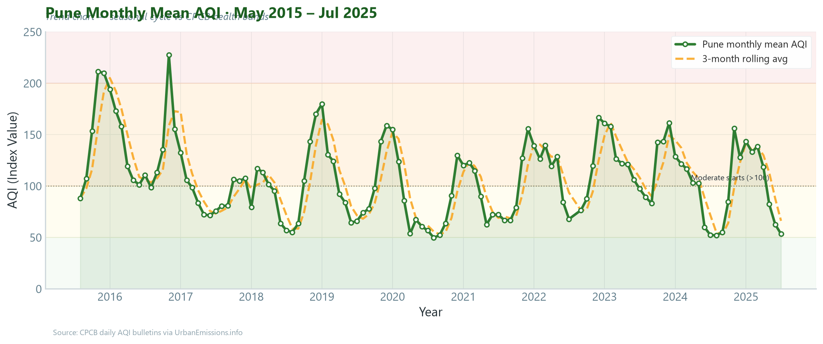
TREND
A Decade of Pune Air Quality
INSIGHT · SEASONAL CYCLE
Pune’s AQI follows a strong, repeating seasonal cycle.
Winter peak in December (~AQI 152);
monsoon low in July (~AQI 70) — a swing
of ~81 points.
Roughly half the year sits in the "Moderate"
band (>100), so residents breathe unhealthy
air on a predictable winter schedule every
single year.
Indian Air Quality · CPCB Data Visualization
3

Slide 4
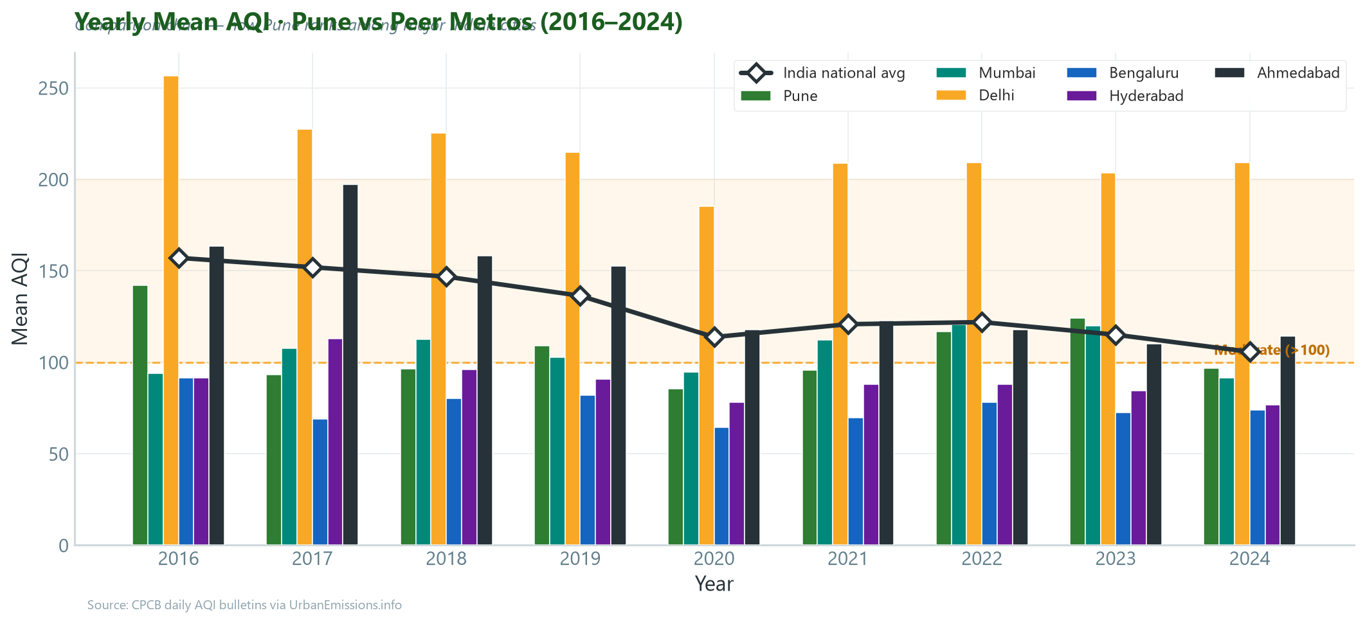
COMPARISON
Pune vs Peer Metros & National Avg
INSIGHT · MID-TIER CITY
Pune is cleaner than Delhi but still
tracks the national average.
2024 mean AQI:
Pune 97 | Delhi 209 | India 106
~112 pts below Delhi, ~9 pts off the
all-India mean — a moderately polluted
city, not a clean one. Vehicle congestion,
dust and biomass keep it in the Moderate
band despite coastal winds.
Indian Air Quality · CPCB Data Visualization
4

Slide 5
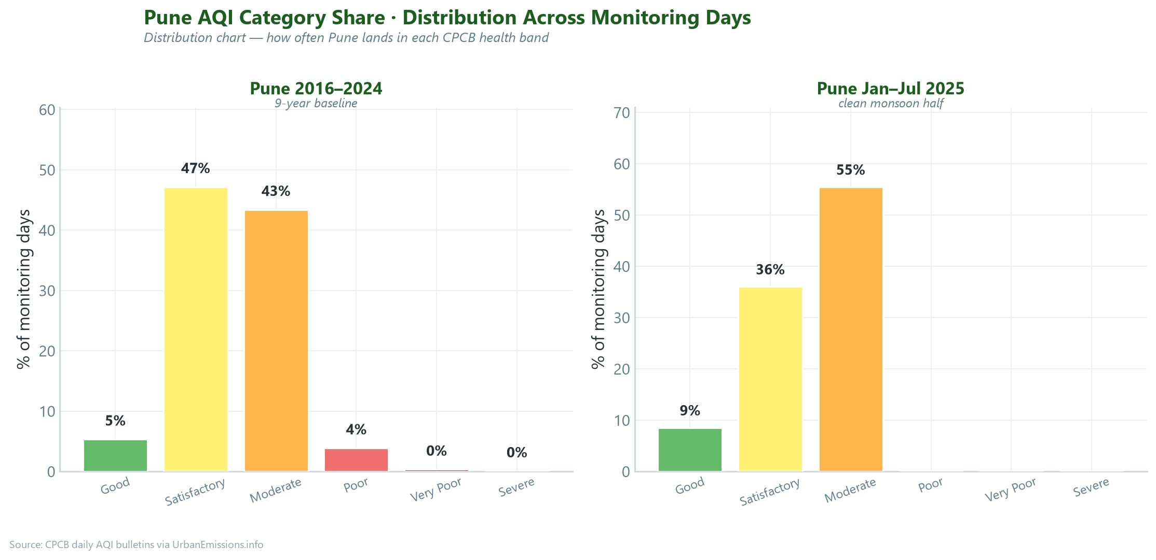
DISTRIBUTION
Where Pune’s Days Actually Land
INSIGHT · RARE "GOOD" DAYS
Most Pune days are "Satisfactory" or
"Moderate"; truly "Good" days are rare.
2016–24: Moderate 43% · Good+Sat 52%
Jan–Jul 2025: Moderate 56% · Good+Sat 45%
Even in the cleaner monsoon half, the
dominant category is still "Moderate".
PROBLEM → DATA → INSIGHT
Vehicle congestion & emissions are a persistent urban burden. 10+ years of CPCB AQI show Pune locked in the Moderate band with winter spikes (Dec ~152). A measurable, recurring air-quality burden exists — targeted interventions (no-idling zones, cycling, green buffers) address the dominant PM2.5/PM10.
Indian Air Quality · CPCB Data Visualization
5

